Slide 1
Spotify Charts Analysis
Alexa Weber
Rahul Singh
Varun Tej Nookala

Slide 2
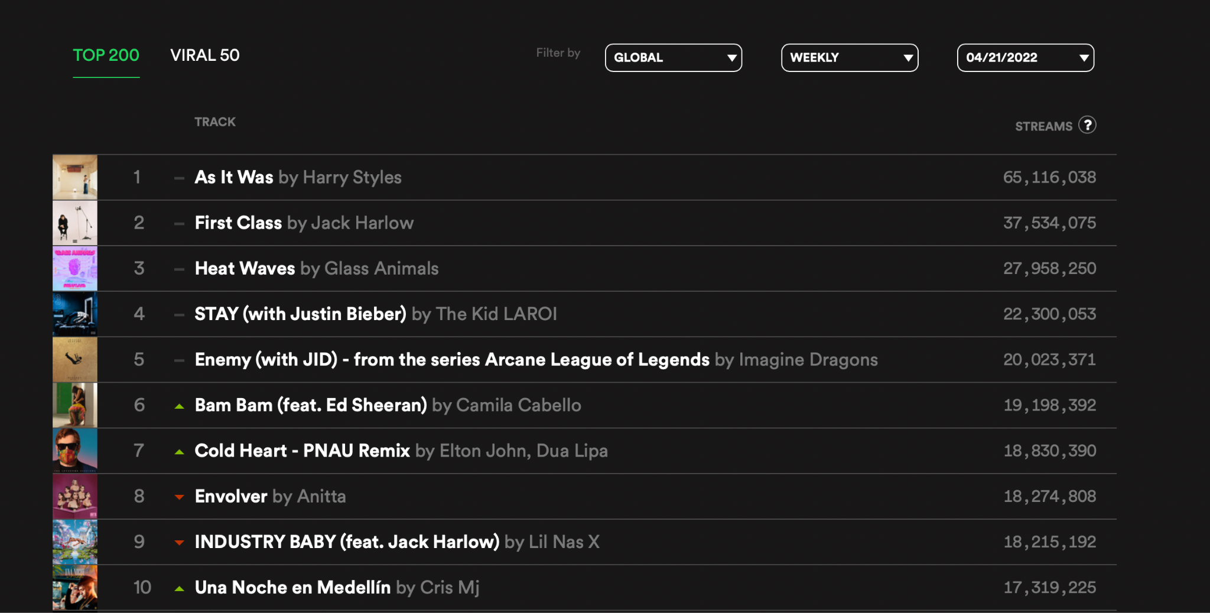
Goal
Analyze Spotify music trends using the Spotify charts website
Notes:
https://spotifycharts.com/regional/global/weekly/2022-04-15--2022-04-22

Slide 3
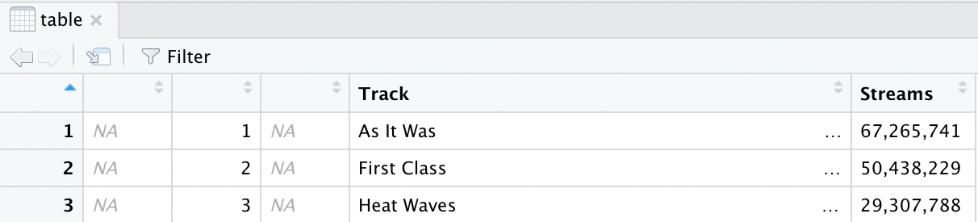
Scraping the Data
Using the rvest library, bring the table into R
It’s quite messy - two columns of NA values, missing Artist column
Notes:
Using the rvest library, I brought the table into R. It’s quite messy, with two columns full of NA values. Notice how the artist column is missing! Hovering over the three dots, we can see it’s all included in the track column.

Slide 4
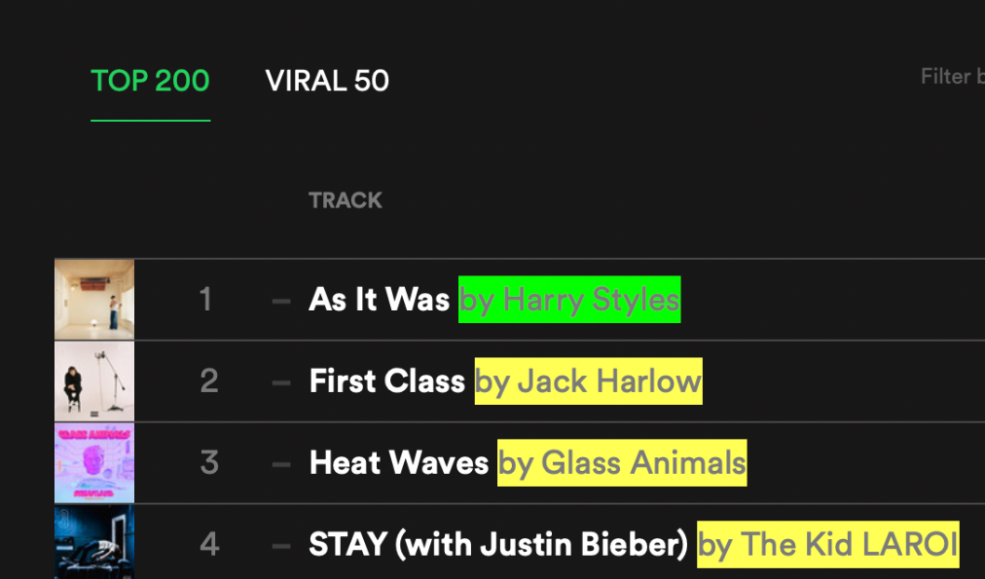
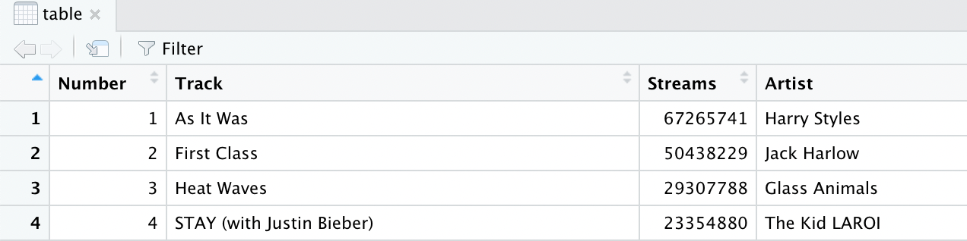
Cleaning
Use Selector Gadget to select the Artist
Add the Artist column to the table
Remove NA columns, remove commas from Streams column and convert to integers, remove extra words from Track column
Notes:
My solution to this problem was to use Selector Gadget to bring in the artists as a vector and add it to the table. Additionally, I got rid of the NA columns, converted the Streams column to integers by removing commas, and removed the extra words from the Track column, leaving just the title.

Slide 5
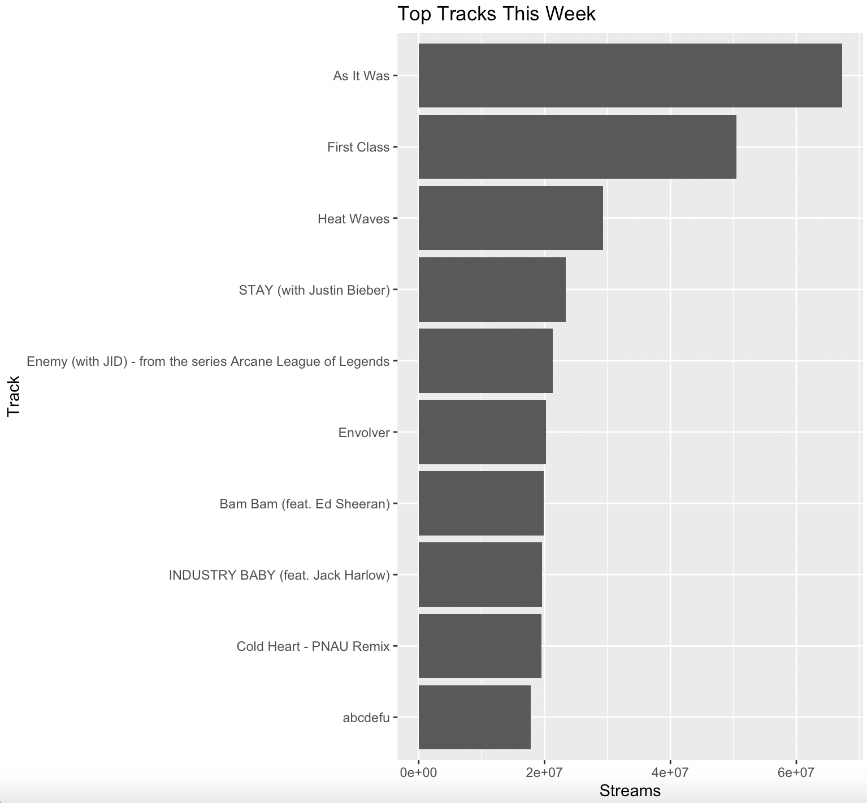
Exploring
Here we plotted the top tracks and number of streams
As It Was by Harry Styles was the most popular song last week with 67,265,741 streams

Slide 6
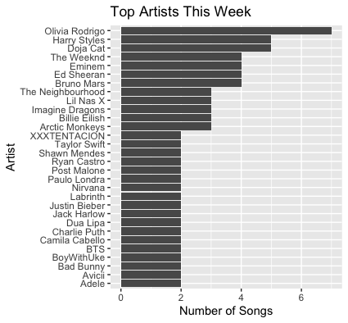
Exploring
Next we see the number of tracks (greater than one) that artists had that week
Olivia Rodrigo had 7 songs on the Top 200

Slide 7
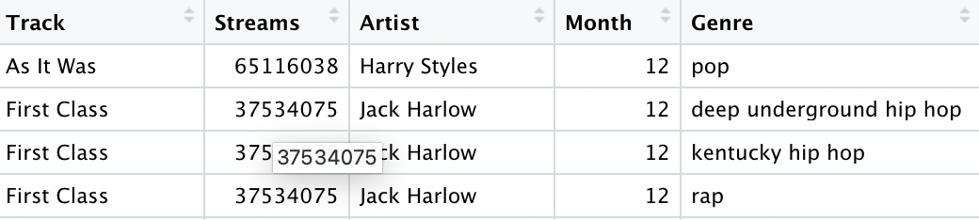
Generating Genre
Using Spotify API to find genre, although there are no explicit genre for each song.
Hence, we can either use genre of album or artist linked
Using album is a bit dicey since singles have no associated genre, and can have overlapping song names
Hence, we resort to Artist Genre, which introduces incorrect but related genres
2 approaches: Individually go through the artists to get genres, or extract all the unique artists, get their genres and map back

Slide 8
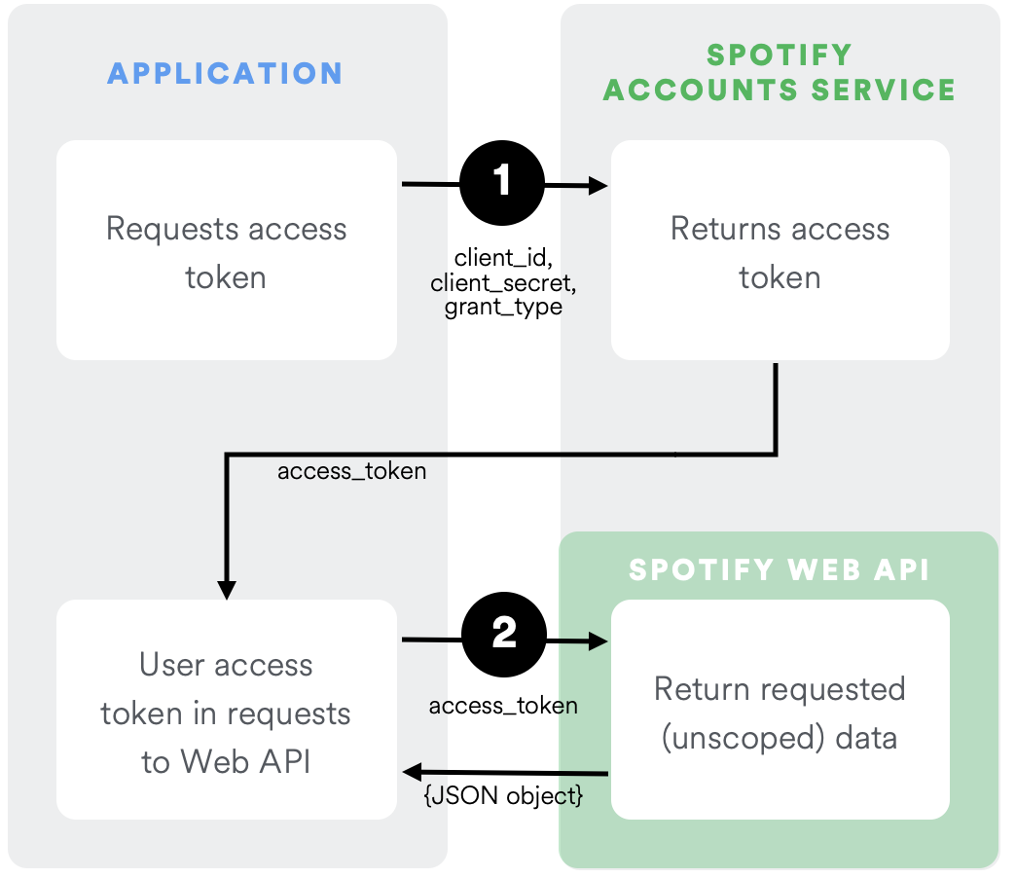
API
Each Artist has their own Artist_Id, but since there is no datasheet for the same, we use the “Search for Item’ API endpoint
Use of these Endpoints requires an Auth0 generated access token requiring client_id and client_secret
Hence, we include a code which constantly regenerates tokens to be used for accessing these API endpoints
Image source: https://developer.spotify.com/documentation/general/guides/authorization/client-credentials/

Slide 9
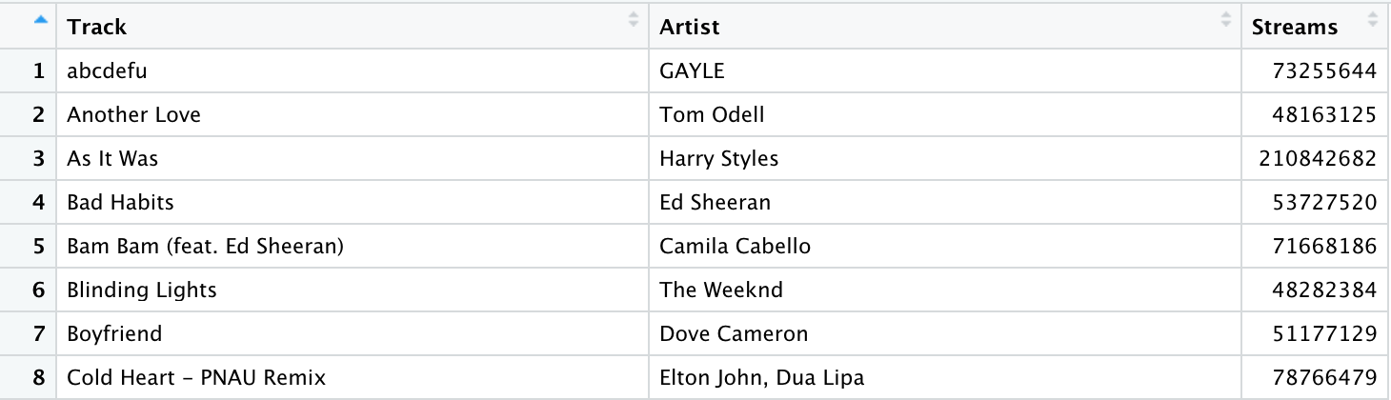
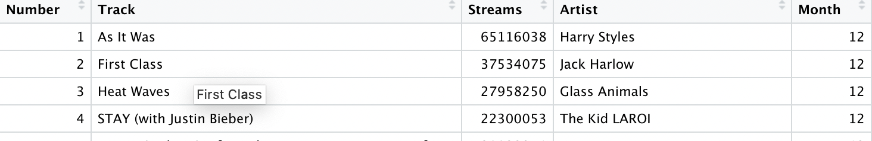
Extending Scraping
The Scraping can be extended for various dates, expanding our table to monthly, as well as yearly!
Trade Off: We now reduce the 200 rows to 50 for feasibility
Implemented function to generate weekly dates, and used scraping as a function (passing number of weeks as parameter) to generate monthly (4 previous weeks) and yearly (48 weeks)

Slide 10
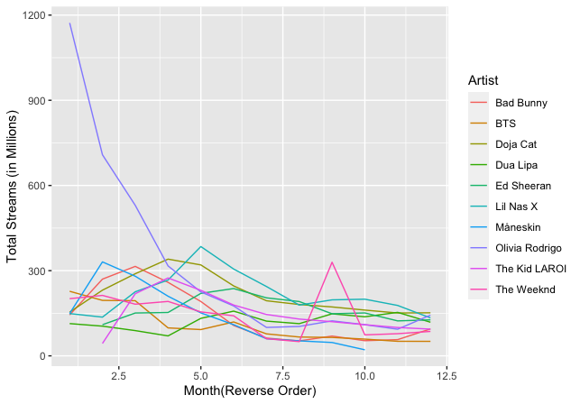
Top 10 Artists (Past Year)
The scraped data for year was aggregated over artists to extract top 10 artists based on total streams
The same was used to find their total streams per month and generate the plot

Slide 11
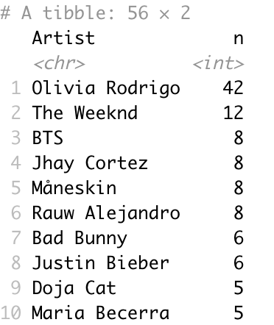
Interesting Find
Investigated the peak month for Olivia Rodrigo
Turns out, she had released a little too many hit songs that month
The tibble shows her appearances in the top 50 week per week for the month of March
Which is approximately 10 songs in top 50 for the entire Month!

Slide 12
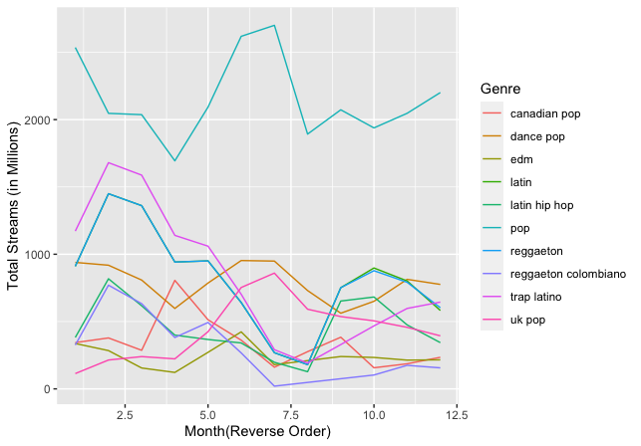
Top 10 Genres (Past Year)
The scraped data for year was aggregated over genres to extract top 10 genres based on total streams
The same was used to find the total streams per month and generate the plot

